Slide 1
Eastern Partnership
Civil Society Forum
CSO bilateral and multilateral platform for association agreement in moldova
September 2015
Notes:
Presentation to provide some broad conclusions and findings from the study on EU Support to the Private Sector in the context of Association Agreements (AA) including the Deep and Comprehensive Free Trade Area (DCFTA) and covers the newly signed agreements in Georgia, Moldova and Ukraine
Research in the 3 countries undertaken between Sept and Dec 2014
The objectives of the study was “to propose recommendations on the design of EU support package targeting the private sector in order to accompany the process of implementation of the AAs/DCFTAs in Georgia, Moldova and Ukraine, notably in relation to the compliance with the EU norms in the domestic legislation.” [and taking advantage of the opportunities it provides to business]

Slide 2
Feedback to previous Qs
How GoM and CSO Platform Works ?
there is no agreement on regular works and I am not sure all relevant public institutions are aware about our platform or our goals and aims.
Thank you to MFA and ME are here and we hope in efficient constructive cooperation.
Today is one way cooperation, ad hoc, upon urgent events and when progress reports are needed or adoption of strategic docs shall be approved.
It’s a tick box
V

Slide 3
Feedback to previous Qs
How GoM and CSO Platform Works / Communicate?
there is no agreement on regular works and I am not sure all relevant institutions are aware about our platform or our goals and aims.
Thank you to MFA and ME are here and we hope in efficient constructive cooperation.
  We should change the approach and just become efficient and set up “friendly” cooperation.
Today is one way cooperation, ad hoc, upon urgent events and when progress reports are needed or adoption of strategic docs shall be approved.
It’s a tick box
V

Slide 4
CIVIL SOCIETY COOPERATION (Ch.26/art.135)
Agreement says:
Parties shall establish a dialogue on civil society cooperation:
  to strengthen contacts and exchange of information and experience between all sectors of CS in the EU and MD
  to ensure a better knowledge and understanding of MD (history, culture, etc) …in particular among CSO based in EU MS;
  to ensure a better knowledge and understanding of the EU in MD.. in particular among CSOs of Moldova, with a non-exclusive focus on the values on EU is founded, its policies and its functioning;

Slide 5
AIMS of dialogue and cooperation
to ensure involvement of CS in EU-MD relations,
  in particular in the implementation of this AA/DCFTA, including its monitoring,;
to enhance CS participation in the public decision-making process, particularly
  by establishing an open, transparent and regular dialogue between the public institutions and representatives of CSO;
to facilitate a process of institution-building of CSOs,
  including: advocacy support, informal and formal networking, mutual visits and workshops in particular in view of improving the legal framework for civil society;
Notes:
MD – art 135
Uckraine – art 444
Georgia 370

Slide 6
Specific sectors in DCFTA Title
IPRs: Art. 332 – Cooperation:
Parties agree to cooperate with a view to supporting implementation of the commitments and obligations.. and areas of cooperation include:
promotion and dissemination of information on IPRs in business circles and CIVIL SOCIETY; public awareness of consumers and
right holders;
Notes:
The Parties agree to cooperate with a view to supporting implementation of the commitments and obligations undertaken under this Chapter.
2. Subject to the provisions of Title VI (Financial Assistance, and Anti-Fraud and Control Provisions) of this Agreement, areas of cooperation include, but are not limited to, the following activities:
promotion and dissemination of information on intellectual property rights in, inter alia, business circles and civil society; public awareness of consumers and right holders;

Slide 7
TRADE AND SUSTAINABLE DEVELOPMENT (art.377)
In July, 2015 – at 1st meeting of Joint Civil Society Dialog Forum agreed that key policy priorities should focus:
1. Addressing the fundamental weaknesses of MD-EU relations (2015) that led to postponement of EU funds:
  forming a functional GoM well-committed to DCFTA implementation and speeding up structural reforms;
  enhancing the transparency of decision making at local and national level;
  Re-building an effective system of sound regulation and supervisory institutional capacities for the banking system and ensuring macro-economic stability;
Notes:
The Parties agree to cooperate with a view to supporting implementation of the commitments and obligations undertaken under this Chapter.
2. Subject to the provisions of Title VI (Financial Assistance, and Anti-Fraud and Control Provisions) of this Agreement, areas of cooperation include, but are not limited to, the following activities:
promotion and dissemination of information on intellectual property rights in, inter alia, business circles and civil society; public awareness of consumers and right holders;

Slide 8
TRADE AND SUSTAINABLE DEVELOPMENT - JCSF
Consolidating and strengthening the capacities of civil society and the civil society platforms
  (CSOs, trade unions, employers’ associations, environment movements, consumers' organizations, chambers of commerce)
in order to ensure a qualitative feedback for the GoM on DCFTA implementation and enforce the checks and balances mechanism between the CSO – GoM:
  It includes enhancement of the quality and the benefits of social dialogue, by capacity building, exchange of information, practical experience and good practice, and
  Interference in activities of trade unions and in general into the activity of the social partners is not acceptable;

Slide 9
TRADE AND SUSTAINABLE DEVELOPMENT - JCSF
Addressing Cost and Quality COMPETITIVENESS issue:
  by easing the access to finances (especially for the small and medium enterprises),
  stimulating the inflows and absorption of technologies at the company level, and
  raising knowledge and awareness among the private sector about the DCFTA implementation;
  Mandatory consultation of the Domestic Advisory Group members [National CS Platform] on the draft laws and regulations elaborated for DCFTA implementation activities;

Slide 10
TRADE AND SUSTAINABLE DEVELOPMENT - JCSF
Addressing the issue of the informal economy, by decreasing the costs of formal economic activity and increasing the penalties of informal economic activities
Adoption and strengthening of the domestic enforcement of the ILO conventions related to social protection of employees;
Removing of NTBs, by speeding up the reform MSTQ, adoption and implementation of EU quality standards, aligning food safety system to EU one, downsizing bureaucracy related to issuing quality certificates, certificates of origin, licenses and other permissive docs, VAT refunds;

Slide 11
TRADE AND SUSTAINABLE DEVELOPMENT - JCSF
Aligning Educational system to the real economy needs, by ensuring functioning of sectorial committees for implementation of EU aligned Employment standards;
Speeding up reforms aimed at most pressing environmental problems: lack of adequate storage and recycling capacities of waste, insufficiency and poor quality of water, poor quality of air and high vulnerability to environmental shocks;
Conducting TSIA of the DCFTArelated to MD challenges, using agreed methodology and indicators.
  !!! Methodology and indicators shall be approved by GoM, but Assessment Reports shall be conducted by independent entities on an annual basis.

Slide 12
AA/DCFTA Audit – Direct Effect on Business
Area of Association Agreement | Likely Impact on business | Sectors potentially affected
Money laundering/crime & corruption | Requirement for increased financial reporting/controls | All
Market access | Market opportunities in EU and cheaper imported inputs | Depending on current structure of tariffs
Approximation of TR, standards, and CA and labelling | Adaption of production and CA. | Manufactures
Approximation of SPS | Compliance with EU SPS and animal welfare standards | Agriculture Agro processing sector of manufacturing
Approximation to EU customs law (customs code) | Procedures for customs administration | All importers and exporters
Approximate on public procurement | Opportunities to bid on EU contracts | Professional services Construction Manufacturers
Phasing out of use of certain GIs in Ukraine and third markets | Rebranding of products affected by GIs | Agriculture Agro processing sector of manufacturing
Notes:
11 areas of agreement with direct effect all business whether exporting or selling locally. 2 other areas for exporters
Each product will be effected differently, so will producers, importers and sellers of the 10,300 different products in the nomenclature
Based on the lists of EU legislation that has to be adopted in the areas that affect business, more than 500 EU Directives will be adopted in each country, plus >5,000 standards up to 10,000 in some countries

Slide 13
AA/DCFTA Audit 2
Area of Association Agreement | Likely Impact on business | Sectors potentially affected
Approximation relating to energy cooperation | Product standards regarding energy and labelling thereof, of products and buildings | Manufacturing Construction Real Estate Professional services
GMO monitoring | Use and control of GMOs | Agriculture
Road transport | Road and vehicle safety | Transport Wholesale/retail Manufactures (of dangerous products in particular)
Company law, corp. governance, accounting and auditing | Changes in corporate governance | All
Environment | Control of industrial pollutions and hazards (vehicle emissions waste and waste water) | Transport Manufacturing (esp chemicals) Agriculture
Health and safety | Safety and health of workers at work,, use of work equipment, personal protective equipment | All sectors Especially construction Manufacturing (esp chemicals)

Slide 14
SME Survey – Level of Understanding of AA/DCFTA
Summary of Findings
no understanding of the scale
little or no understanding of specific scope and coverage
limited resources available for needed changes
Notes:
Detailed Q, with 33 questions broken down by country, region, sector Example of results
Amongst the SMEs surveyed, there is no understanding of the scale of changes that will result from AA/DCFTA implementation and how it will affect business:
Only 2% in georgia and 1 % in Moldova thought the agreement would have a high effect on business, and although 43% in ukraine, 61% of these thought only exporters affected
Even amongst those SMEs that knew of AA/DCFTA there is little or no understanding of specific scope and coverage and how it will impact on business:
less than half say they understand except tech regs in ukraine
Even where SMEs claim knowledge of AA/DCFTA requirements, many did not actually understand the requirements with a door producer stating GMO and GI would affect his business where clearly there would be no impact.
SMEs reported limited resources available to effect the needed changes arising from implementation of the AA/DCFTA:
Between on quarter and half of SMEs in the region believe that they have internal resources to be able to implement the necessary changes but between 13 and 33% stated they had sufficient internal finance to fund investment. Only 7-20% of SMEs thought they would be able to raise external finance.

Slide 15
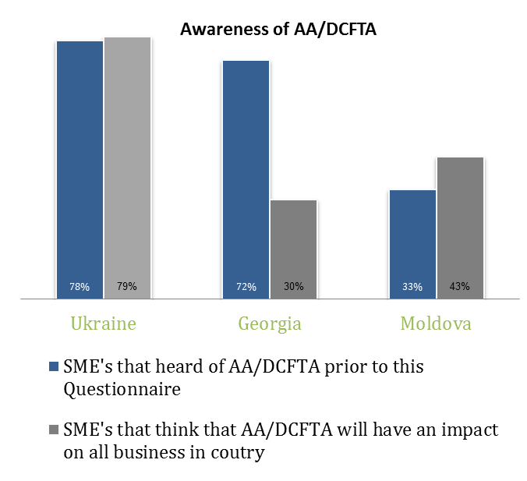
After signature (June 2014) of AA/DCFTA – CSO National Platform actions:
6 000 leaflets about the DCFTA and AA
1,000 brochures about AA/DCFTA
800,000 postal cards about the
benefits of the EU Association Agreement
12 posters and 40 000 EU binders
8 editions of the ''European Objective'‘
newspaper in RO and RU
(100 000 copies published and distributed
intensively broadcasted on TV stations
with national coverage door-to-door campaign, “Euro-buss” in 70 localities of Moldova;
Platform supported of the newly created European Informational Centres in Chisinau, Comrat, Balti and Cahul including the “Days of European Culture”, www.infoeuropa.md - web portal

Slide 16
How to set a Bilateral dialogue
National Platform
Governments and Authorities
Develop and write development and monitoring projects
Be involved in setting-up indicators to measure the level of implementation
Be involved in discussions of progress reports on level of implementation
Strengthening the capacity building of the National Platforms and its members on understanding the DCFTA goals and aims of monitoring process
Support and look for funds to finance CSOs projects
Set up indicators and outcomes goal for each action of the DCFTA Action Plans
Submit its Progress Reports after consultations with CSOs;
Express partnership and actively participate in National Platforms activities

Slide 17
Thank You
Questions and Answers
Further Information:
gmincu@yahoo.com

